Slide 1
Message Authentication: Secure hash-based constructions

Slide 2
Confidentiality ≠ Integrity
Confidentiality
Message hiding
Only the legitimate destination should be able to see the content of a message
Integrity
Message authenticity
Nobody should be able to modify a message while in transmission
Only the legitimate source should be able to forge a message
Corollary: you MUST have secret key (remember WEP CRC ☺)
Encryption does NOT guarantee any integrity!
Exception: AEAD ciphers (Authenticated encryption): designed to guarantee both confidentiality and integrity
Integrity-only: often is the only thing you want

Slide 3
Message authentication (with symmetric key)
Key: secret known by both sender and receiver
Key: secret known by both sender and receiver
k
k
message m
tag
Sender
Receiver
Generate tag
Verify Tag
K
message
Tag sent along with message
Received
message
K
Generate tag
Generate tag
tag
Cryptographically strong function: Input: K, message output: short authentication code
Not reversible! (output shorter than input)
Received
Tag
=?
Y/N = message OK/NO

Slide 4
Message authentication: what it does NOT protect?

Slide 5


Protects from MITM attacker
message m
TAG
TAG = F(K, m)
Modify
m → m*
But (assumptions on F = cryptographically strong):
Sees TAG & m: must NOT be able to «invert» F and get K
Cannot change TAG→TAG*=F(K, m*) without knowing K
Cannot change m→m* such that F(K,m)==F(K,m*)
message m*
TAG
F(K, m*) = TAG* ≠ TAG
Someone modified m!!

Slide 6
Protects from message spoofing
Spoofed message X
TAG = F(K,X)
?????
(assumptions on F = cryptographically strong):
Cannot compute F(K, X) without knowing K
Spoofed message X
Invalid TAG
F(K, X) ≠ TAG
Spoofed message!

Slide 7

Does NOT protect from replay attacks
I’m sending the same message twice
as I really want to pay 2000$
Pay 1000 $
TAG
Pay 1000 $
TAG
Let’s stop. I just want to pay $1000 once.
Ops! This is a valid message!
Pay 1000 $
TAG
Pay 1000 $
TAG
Nah! I’ll make you pay twice!!

Slide 8
Preventing replay attacks: Nonces
Replay attacks prevented if ALL messages are different each other!
How to?
Application MAY legitimately send two identical messages!
Add «nonce» to each packet
Nonce=«fresh» information, guaranteed to differ in each message!
Does not have to remain secret → can be added to the msgin clear
Sequence number
Random number
Time stamp
and include it in the TAG computation!
N_{x}
Pay 1000 $
TAG
N_{y}
Pay 1000 $
TAG

Slide 9
Test your understanding
Which pros and cons of each type of nonce?
Sequence number?
How to manage «reboots» ☺ ?
Random numbers?
How RX can control that packet is a fresh one?
Time stamps
Who guarantees time? «now» is really «now»?

Slide 10
MAC = Digital Signature?
Digital signature (DS):
Nobody can modify a digitally signed message (except creator)
Message Authentication Code (MAC):
Nobody except TX and RX (which have the key) can modify a MAC-authenticated message
Both have an identical purpose!
Message/data Integrity
But unlike MAC, DS further guarantees non repudiation (source authentication)
DS = stronger form of authentication than MAC
But requires different crypto → asymmetric, more later
Why this is useful? Legal scenarios, Multicast scenarios

Slide 11
Defining Security for Message Authentication Codes
message M
TAG(K,M)
Security = Unforgeability
Attacker should not be able to create or modify a message
Implies that attacker should not be able to extract key from pair {M, TAG(K,M)}
Formally: a game against an attacker model
From weaker to stronger: Known Message Attack → → Chosen Message Attack → Adaptively Chosen Message Attack
Attacker is given (may choose) a number of past message/tag pairs
(m₁,t₁), (m₂,t₂), (m₃,t₃), …
Now sees (choses) message m: must be unable to forge tag
More specifically: probability to forge valid pair must be NEGLIGIBLE

Slide 12
Test your understanding
1 byte tags
No way for attacker to guess tag from msg, beyond pure random choice
Is this secure?
NO! Probability of guessing = 1/256
Not nearly negligible!!
Note the crucial difference with encryption security definitions!

Slide 13
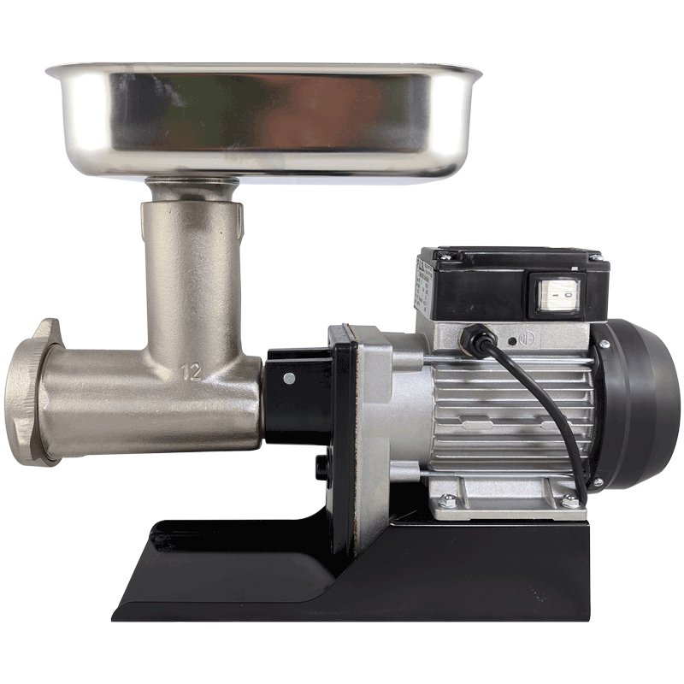
Which (highly non linear) function can we use? Hash function? What’s this?

Slide 14
What is a Hash function?
Any length message X
Y = H(X)
Fixed size digest Y
Arbitrary size X → fixed size Y=H(X)
(from as short as 1 single bit to… any size) → e.g. exactly 256 bits for SHA256
Y=H(X): “fingerprint” (short summary) of X
H(X) should be relatively easy to compute for any given X, making both hardware and software implementations practical

Slide 15
Cryptographic hash functions
Hic ego: laudare igitur eloquentiam et quanta vis
sit eius expromere quantamque eis, qui sint eam
consecuti, dignitatem afferat, neque propositum
nobis est hoc loco neque necessarium. hoc vero
sine ulla dubitatione confirmaverim, sive illa arte
pariatur aliqua sive exercitatione quadam sive
natura, rem unam esse omnium difficillumam.
quibus enim ex quinque rebus constare dicitur,
earum una quaeque est ars ipsa magna per sese.
quare quinque artium concursus maxumarum
quantam vim quantamque difficultatem habeat
existimari potest.
Hic ego: laudare igitur eloquentiam et quanta vis
sit eius expromere quantamque eis, qui sint eam
consecuti, dignitatem afferat, neque propositum
nobis est hoc loco neque necessarius. hoc vero
sine ulla dubitatione confirmaverim, sive illa arte
pariatur aliqua sive exercitatione quadam sive
natura, rem unam esse omnium difficillumam.
quibus enim ex quinque rebus constare dicitur,
earum una quaeque est ars ipsa magna per sese.
quare quinque artium concursus maxumarum
quantam vim quantamque difficultatem habeat
existimari potest.
H[ ]
H[ ]
c6c8258947bffe06ea4a0c8132af337a3c74ec81d754a96d5a29e3ca7d8ce49d
3238ead7fb611463703c47adc4215aa245a1f1a4a0cea4c11296b466a76bbac4
Fixed size digest
(e.g. SHA-256: 64 hex)
No way for an attacker to either create or purposedly modify/extend/replace initial text so as to obtain original digest!!

Slide 16
Property #1 of a cryptographic hash function
Preimage resistance (one way)
Given Y = result of a hash, it is hard to find ANY X such as H(X)=Y
? ? ? ?
One way: much more than
«non-invertible»
Infinite (!!) messages can generate this digest
but you should NOT be able
(in a reasonable time)
to find ANYONE of such messages!!
Digest:
c6c8258947bffe06ea4a0c8132af337a3c74ec81d754a96d5a29e3ca7d8ce49d

Slide 17
Parenthesis: Hash functions: computational security
Should resist to brute-force (repeated trials)
Consequence: digest cannot be small!
It rather has to be relatively large (e.g. 256 bit)
Example: 16 bit digest→ 2¹⁶ possible outputs → 65536 values
Assume «random» message→digest mapping (best possible hash function)
Average number of trials to have a success is also 2¹⁶=65536
Less than 1ms on my PC (66 Mhash/s)
Obviously a large digest is NOT NEARLY ENOUGH!
Crypto hash functions are very carefully designed to resist to cryptoanalysis
Example: SHA-1 has 160 bit, but as of today (march 2020) can be broken with only about 2⁶¹ attempts (practical with today technology)!!

Slide 18
Property #2 of a cryptographic hash function
Second preimage resistance (weak collision resistance)
Given X, it is hard to find another X’ such that H(X) = H(X’)
Good Message M:
Cari ragazzi non potete modificare questo messaggio se, come prova di quanto sto scrivendo, conservo la sua hash in una mia penna usb
? ? ? ?
Attacker cannot find ANY other message which has the same hash
Stronger property than one-wayness!
there are functions which satisfy property #1 but fail property #2
Digest:
920d7e8cf22725391c2415ade26358f8c099ed37837e1a8911786b0e3684f23c

Slide 19
Test your understanding (non trivial example)
Modular exponentiation
Y = F(x) = g^{x} mod p
g known value (not necessarily large)
p = (very) large prime
F(x) is one-way, i.e. satisfy property #1
In most cases (more later for details on how to choose g and p)
Show that it is NOT collision resistant
i.e., does not satisfy property #2
Hint: it is a periodic function, and if you find the period… game over! Why? ☺

Slide 20
Property #3 of a cryptographic hash function
Collision resistance (strong collision resistance)
Ii is hard to find two generic X1 and X2 such that H(X1) = H(X2)
Weak collision resistance: target message
Target message X1
X2
X3
X4
X5
X6
13452
54678
34199
90076
77111
34199
Strong collision resistance: ANY message
message X1
X2
X3
X4
X5
X6
13452
54678
34199
90076
77111
34199

Slide 21
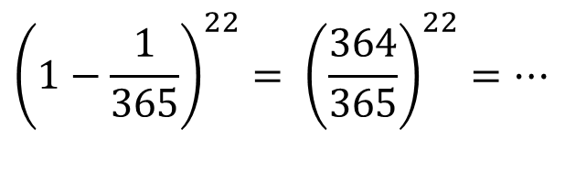
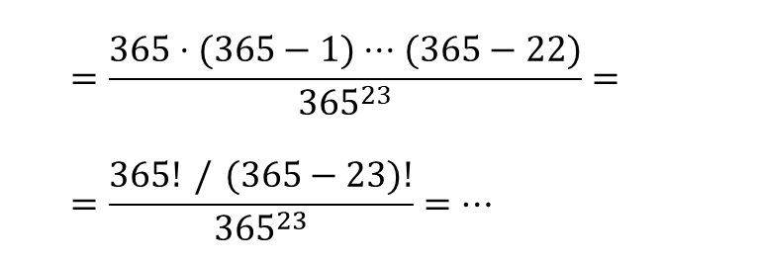
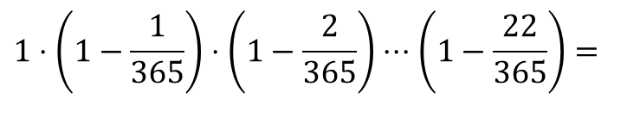
Birthday paradox
23 people are in a class
(22 + myself)
H
Human being X → birthday
What is the probability that none of you N=22 is born in my same day?
What is the probability that no two+ of us N=23 are born the same day?
$${\left(1−\frac{1}{365}\right)}^{22}= {\left(\frac{364}{365}\right)}^{22}=…$$
94.1%
= you have my same birthday in less than 6% cases
$$1⋅\left(1−\frac{1}{365}\right)⋅\left(1−\frac{2}{365}\right)⋅⋅⋅\left(1−\frac{22}{365}\right)=$$
$$=\frac{365⋅(365−1)⋅⋅⋅(365−22)}{365^{23}}=$$
$$=\frac{365! / (365−23)!}{365^{23}}=…$$
49.3%
In more than 50% cases two of us have the same birthday!!! Not so obious…

Slide 22
Birthday paradox math
n bit digest → N=2^{n}
K = n. messages
p = collision probability
Remember: for x small,
1-x approx e^(-x)

Slide 23
Birthday paradox math
So, we concluded that:
Let’s solve in K:
50% (p=1/2) collision probability:
And since N=2^{n}, using n bits:
Conclusion: n-bit digest → security level is NOT 2^{n} but 2^{n/2}

Slide 24
Hash digest size
Must be assessed against birthday paradox!
32 bits (RAND) → 4.3 billion outputs
But 50% collision after 2¹⁶ ~ 60.000 msg (very little!)
128 bits (MD5) → 50% collision after 2⁶⁴ = 1.8x10¹⁹ (weakish today)
but MUCH worse than this: MD5 broken via cryptoanalysis since 2005
256 bit (SHA256) → 50% collision after 2¹²⁸ = 3.4x10³⁸, OK today
3.4x10³⁸ → ~ 2000x 4 superenalotto in a row ~ 1 billion centuries of work by whole worldwide bitcoin network (march 2020 ~ 10²⁰ H/s)

Slide 25
Back to Message authentication!

Slide 26
Message Authentication Code using hash functions ingredient 1: good hash
Good
Message
M
Bad
Message
M’
Good crypto HASH:
Today: SHA-2 family (SHA256, SHA224, SHA384, SHA512)
Past: SHA1, MD5 (both broken)
next: SHA-3 family (still 224, 256, 384, 512, but new construction)
Most common (used in TLS & Ipsec) trivial to use (e.g. linux sha256sum command)
(well, apparently ☺ - devil is in details, more later!)
HASH(M)
VERY HARD to find message M’ whose
Hash is the same of M (collision resistant hash)

Slide 27
Message Authentication Code using hash functions ingredient 2: include secret in the hash
Good
Message
M
Bad
Message
M’
secret = authentication key
Since it is not know by
attacker, computationally hard to construct a valid
message authentication code
HASH(Secret, M)
HASH(????, M)

Slide 28
Where to put authentication key in hash?
H(M || S)?
H(S || M)?
Dear all, I’d wish to authenticate this message. Let me hash this along with a secret.
Dear all, I’d wish to authenticate this message. Let me hash this along with a secret.
0c8132af337a3c74 ec81d754a96d5a29
Auth key K
Message M
Message M
0c8132af337a3c74 ec81d754a96d5a29
Auth key K
Tag
3596c18d7c6f7b5df983b1edb5f7a0d3ddb8b1d041d202a1fc9b5fb4916d20ed
12d6aeadec831f55eb5b0556a0f7e52ce241451ad2556aa70c04e7f32ee4b19
Tag
Some other fancy way? E.g. «envelope»: H(K||M||K)?
But why you ask? Silly question, why should we care?

Slide 29
We would NOT care IF hash function were a «perfect» one: Random Oracle
«oracle» = black box model
Random oracle:
Given any distinct input X, H(X) = truly random value
But with repeatibility property: same input X, same output H(X)
Fact: NO practical hash function can be a random oracle
Digest cannot be a «truly» random value

Slide 30
But WE HAVE TO BE CAREFUL! devil is in details…
Matter is: Hash functions are not black boxes!

Slide 31
Hash constructions: iterative
Merkle-Damgard construction – example: SHA-256
but all practical hash functions of yesterday (e.g. MD5, SHA1) and today use this –only SHA-3 differs ☺
Length K mod 2⁶⁴
K bits
Padding
SHa256 IV:
H₀⁽⁰⁾: 6a09e667
H₀⁽¹⁾: bb67ae85
H₀⁽²⁾: 3c6ef372
H₀⁽³⁾: a54ff53a
H₀⁽⁴⁾: 510e527f
H₀⁽⁵⁾: 9b05688c
H₀⁽⁶⁾: 1f83d9ab
H₀⁽⁷⁾: 5be0cd19
Message (any size)
10000
N x 512 bits
Chunk (512 bits)
Chunk (512 bits)
Chunk (512 bits)
Chunk (512 bits)
F
F
F
F
Initialization Vector
256 bits
256 bits
256 bits
256 bits
256 bits
Hash result
Constant: always the same!
For same M, H(M) must not change!
Compression function 3→1 (256+512 → 256)
The «heart» of the specific hash function used
Merkle-Damgard theorem: if F resistant, also iteration is

Slide 32
Secret Suffix: H(M,S)?
State precomputation, once!!
Brute-force attack to secret
Message (any size)
Secret
pad+len
N x 512 bits
Chunk (512 bits)
Chunk (512 bits)
Chunk (512 bits)
Chunk (512 bits)
F
F
F
F
IV
256 bits
256 bits
256 bits
256 bits
256 bits
Hash result
Weakened security: from N compression blocks per trial, to just 1!
Even worse: collision on msg → collision ALSO on MAC!

Slide 33
Secret Prefix: H(S,M)?
Expansion attack!
Message extension does not require knowledge of secret
Secret already “used” in the (now known) hash state
Secret
Message (any size)
pad+len
msg extension
N x 512 bits
Chunk (512 bits)
Chunk (512 bits)
Chunk (512 bits)
Chunk (512 bits)
Extra chunk
F
F
F
F
F
IV
256 bits
256 bits
256 bits
256 bits
256 bits
256 bits
Previous MAC code
Valid MAC for extended message!!!!
Practical attacker might need to still overcome pad/len-strengthening….
But in terms of security, we have forged a new message
without knowing the secret key → security broken!

Slide 34
Expansion attack!
Trivial to “extend” the message!
Especially critical if secret at the beginning
Example: start from SHA256(k | x), k unknown secret
Append y
To compute SHA256(k | x | y) use iterative Merkle construction!
No need to know k!!!
Length (Damgard) strengthening: helps but does not solve the problem
A strong reason to use different constructs (HMAC)
http://csrc.nist.gov/pki/HashWorkshop/2005/Nov1_Presentations/Puniya_hashDesign.pdf

Slide 35
HMAC to the rescue!
Lesson learned so far: A secure hash is not enough!
Actually, a secure hash may yield a completely insecure MAC (e.g. expansion attack)
Question: is there a «secure» way to include a secret in a hash?
Irrespective of the specific hash construction
hash should be considered as a black box!
Yes: problem solved in 1996: HMAC
Original paper: Bellare, Canetti, Krawczyk, Keying hash functions for message authentication, crypto 96
standard: IETF RFC 2104
Provably secure construction
«pluggable» hash (you choose/replace it)
(more or less) same performance of used hash

Slide 36
HMAC construction
HMAC_{K}(M) = H(K⁺ ⊕ opad || H(K⁺ ⊕ ipad || M))
K⁺ = shared key, but “extended” to block size
E.g. SHA256 → padded with zeros up to 512 bits
Makes sure secret uses the entire first hash chunk
512 bit Chunk (SHA256 example)
128 bit secret
00000000000000000000000000000000000
⊕
00110110.00110110. 00110110.00110110. 00110110………
opad = 0x36 = 00110110 repeated as needed
ipad = 0x5C = 01011100 repeated as needed
We would need TWO different (inner and outer) secrets, but since we have only one, let’s “pseudo-randomly” derive inner and outer keys from the single key
(roughly) equivalent to NMAC construction: H(K_{o} || H(K_{i} || M))

Slide 37
HMAC - diagram
magic value (flips half of key bits)
K⁺ ⊕ ipad
message
Inner key
Msg chunk
Msg chunk
Msg chunk
Output of inner hash (with secret as prefix)
F
F
F
F
IV
256 bit
256 bit
256 bit
another magic value (flips different bits)
outer key
Inner hash
pad
Sort of “encrypted” IV for the message!
K⁺ ⊕ opad
F
F
Outer message: still secret prefix but no expansion possible as message is hashed!
IV
256 bit
HMAC
Just two extra compression blocks
Complexity: from N to N+2
“locks” HMAC: Attacker cannot know such “encrypted” IV

Slide 38
HMAC security
quantitatively proven robustness: as secure as its underlying hash is
see Bellare, Canetti, Krawczyk paper for math proof
we will not dig into this, further
Actually more secure (surprise!)
Bellare 2006: collision resistence NOT necessary
Pseudorandomness is the only requirement
You might even still use HMAC with MD5 or SHA-1 even if they are both broken - there are algorithms to compute collision

Slide 39
Collisions without HMAC
Collision in hash = collision in MAC
H(M,S) construction:
Obvious
find collision on first part of the message, then expand
H(S,M) construction:
less obvious, but same problem
Start from H(S,x) → IV
Find collision H*(IV,X1)=H*(IV,X2)
Mi = x | pad(x) | Xi | pad (Xi)
Hence H(S,M1)=H(S,M2)

Slide 40
Take-home
In crypto, NEVER use a function which is «more or less» close to your needs
Rather, ONLY use functions SPECIFICALLY designed for your PRECISE need!
Hash: seemed OK, but was NOT!
We needed to create a new function, HMAC

Slide 41
Summary
Confidentiality ≠ integrity
Message authentication (symmetric key)
And formal definition of a secure MAC scheme
Replay attacks → MAC not enough → nonces
Ideal vs real world hash functions:
Perfect hash: Random Oracle
Real world hash: Iterative (merkle-damgard) constructions
How to include key in hash? Non trivial!
Solution: HMAC construction

